Slide 1
CUSTOMER REVIEW INSIGHT AI
Advanced NLP System for Aspect-Based Sentiment Analysis

Slide 2

My Team :
Lakshmi Akhila
Hemalatha
Amala Kanaparthi
Thirumalesh
Jyostanand Dwivedi
Sciddhanto Sinha
Under the guidance of
Mentor Mr. MUKILAN SELVARAJ

Slide 3

INTRODUCTION
Businesses receive thousands of reviews daily, making manual analysis nearly impossible. Traditional sentiment analysis shows only overall opinion, missing specific details.
Our Customer Review Insight AI uses Aspect-Based Sentiment Analysis (ABSA) to identify features like battery, camera, or service and detect sentiment for each. This delivers granular, actionable insights that help businesses improve products, services, and customer satisfaction through data-driven decisions.

Slide 4
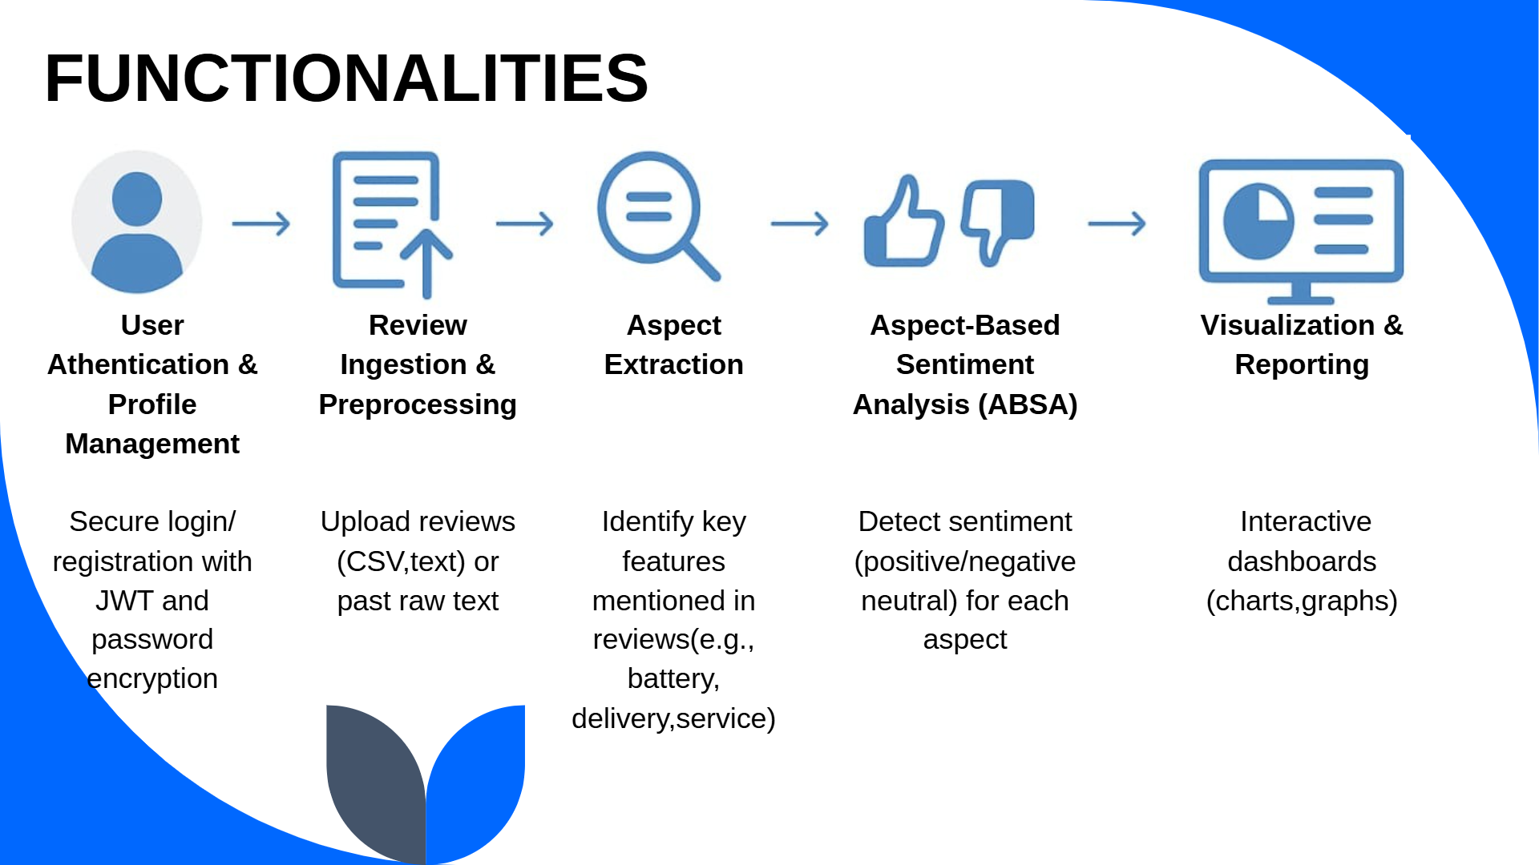

Slide 5





🛠️ Tools & Technologies Used
Programming: Python
Framework: Flask
Database: SQLite + SQLAlchemy ORM
Authentication: Flask-Login, JWT
Frontend: HTML, CSS, Bootstrap, JavaScript
Visualization: Chart.js , Matplotlib
NLP: NLTK (VADER), Hugging Face Transformers
Data Processing: Pandas
Server: Flask Dev Server

Slide 6
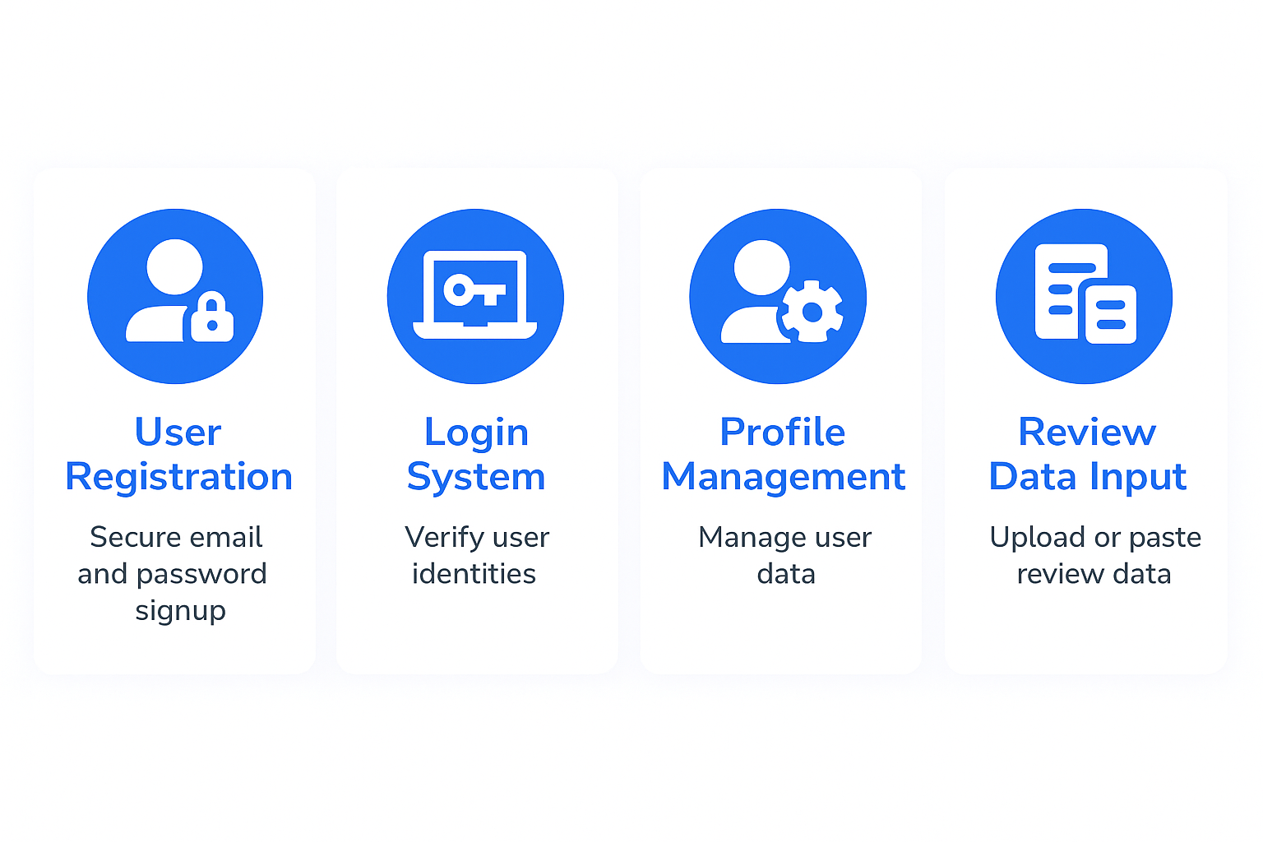
MILESTONE 1 USER AUTHENTICATION & REVIEW INGESTION

Slide 7
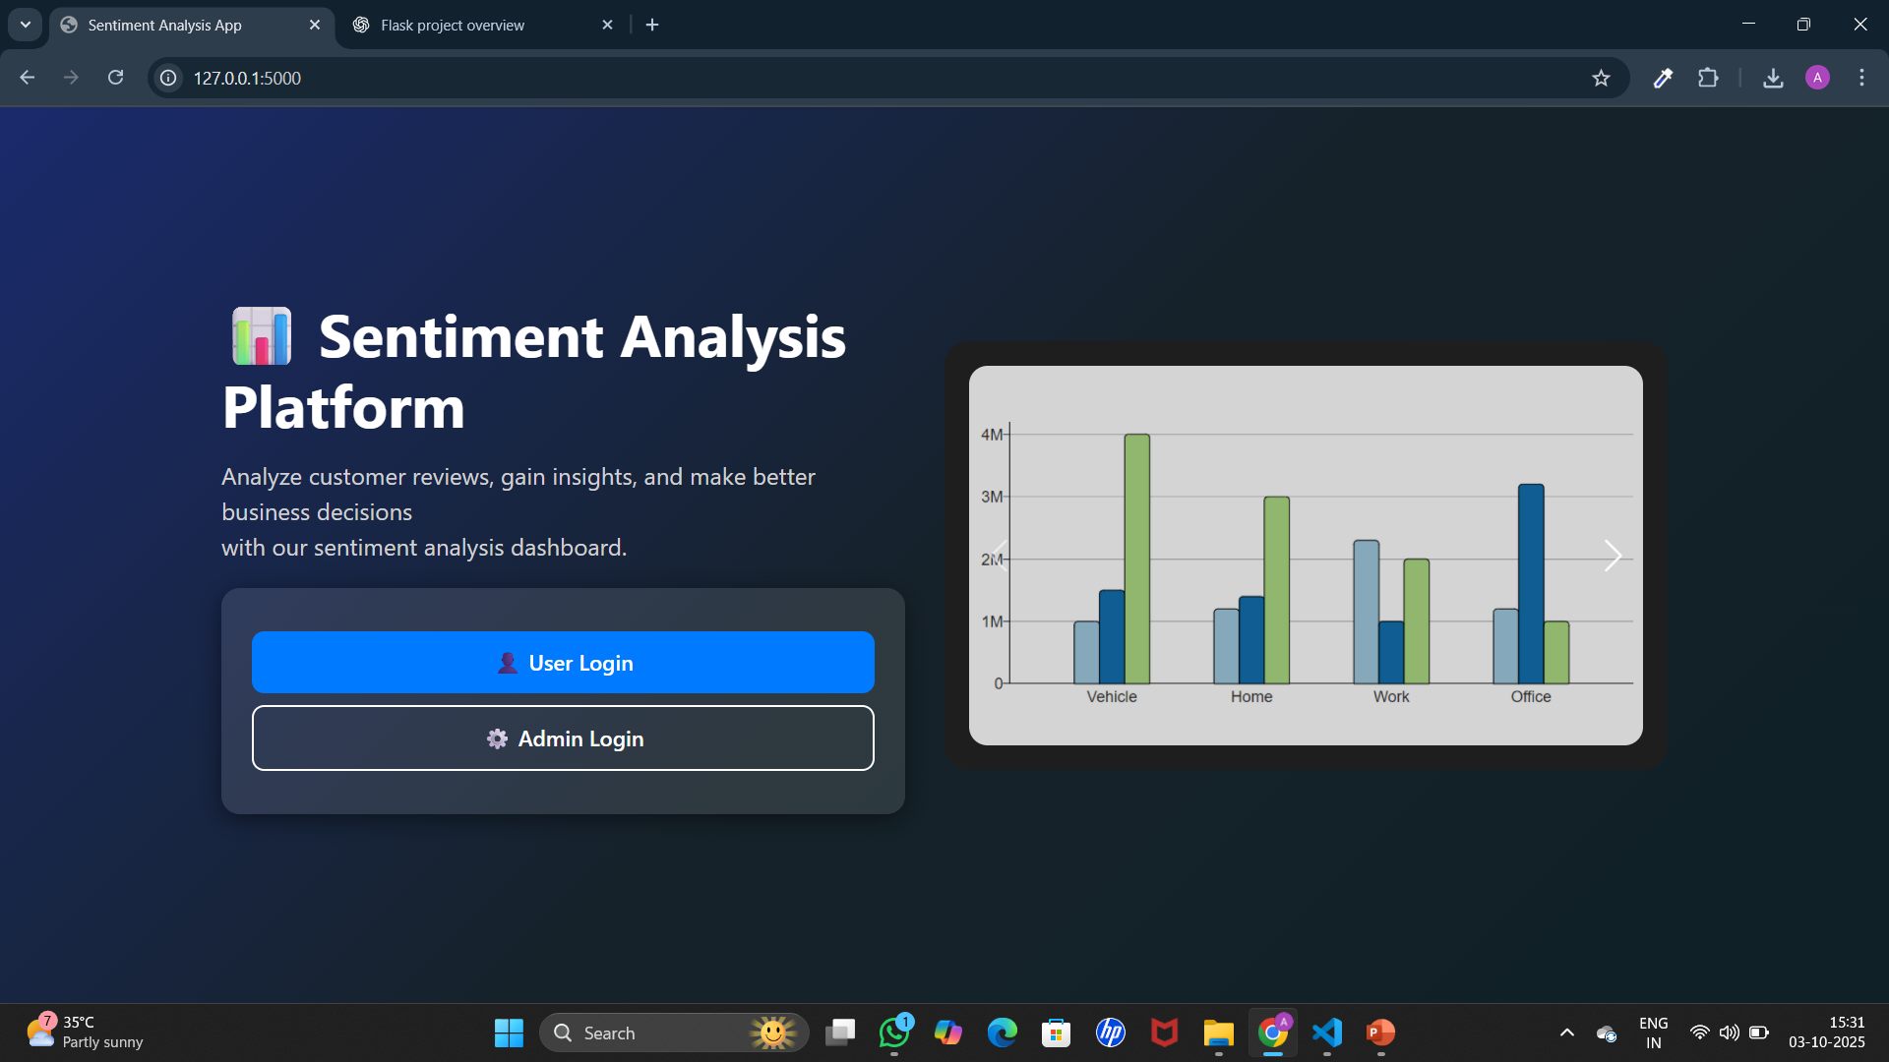
Home Page

Slide 8
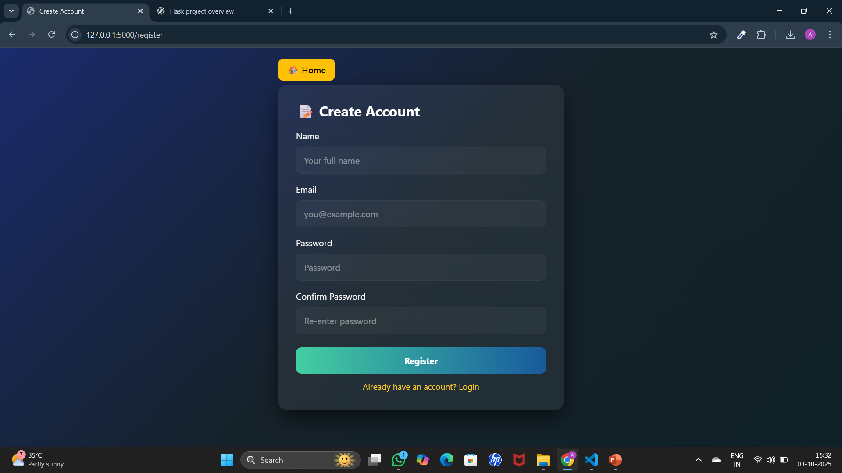
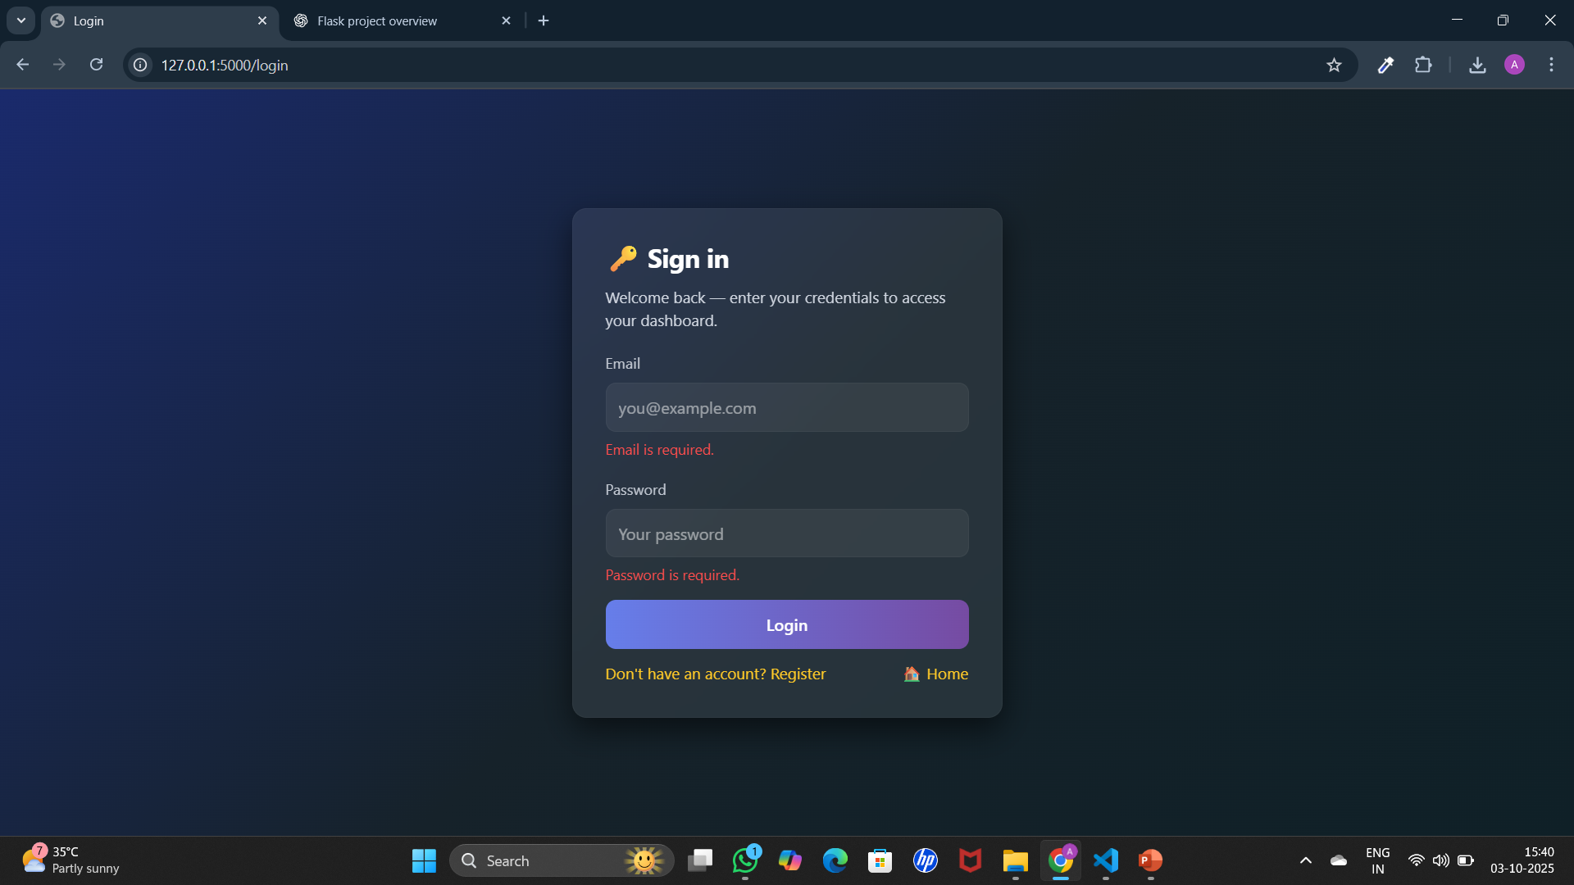
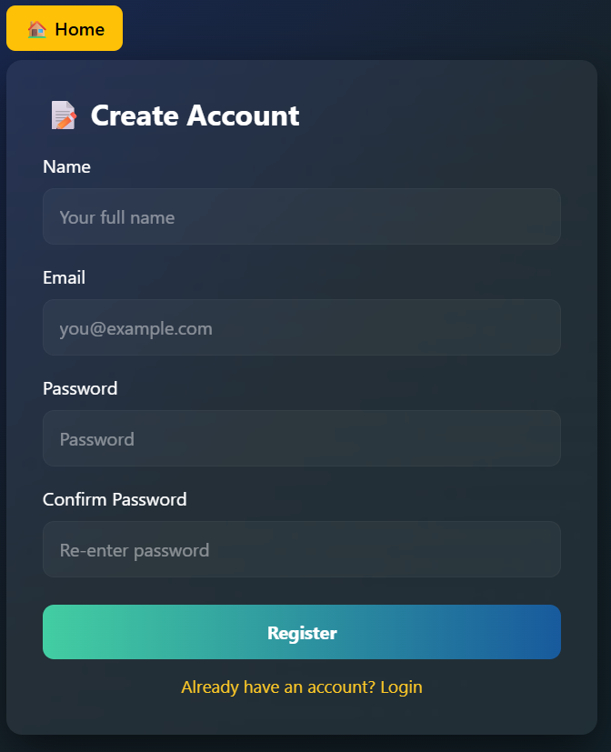
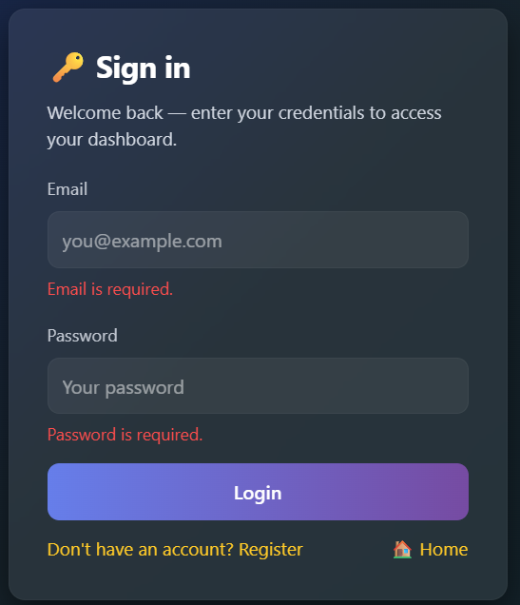
Register Page Login Page

Slide 9
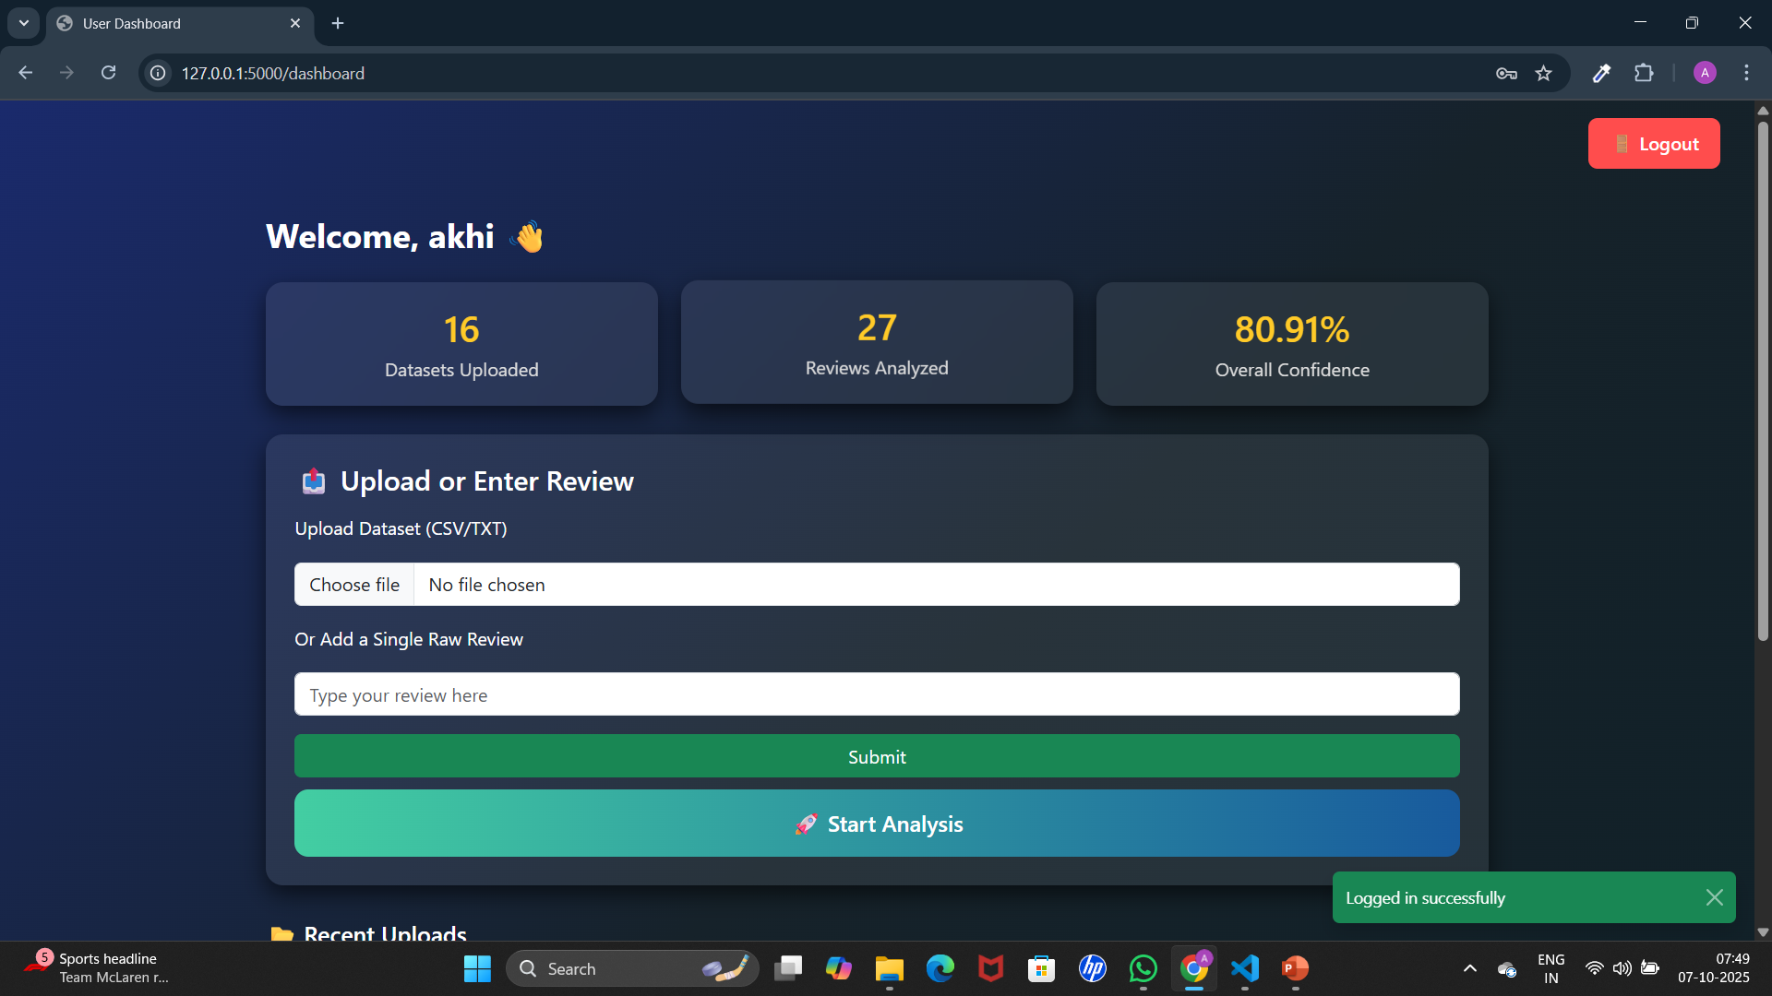
User Dashboard Page

Slide 10
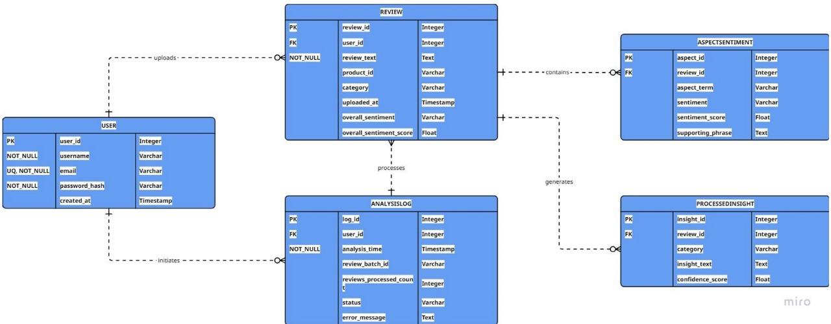
Database Schema

Slide 11
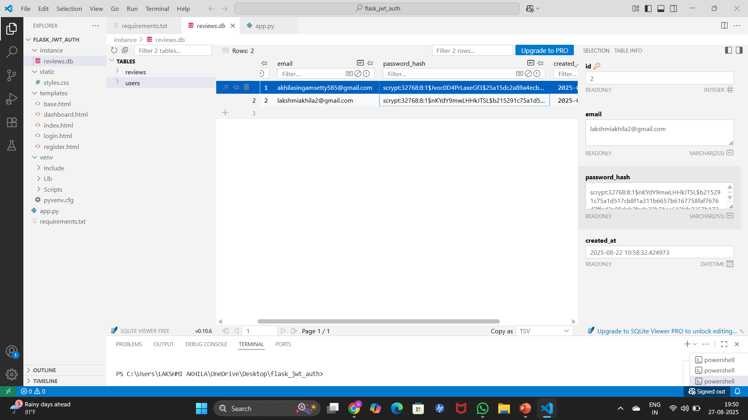
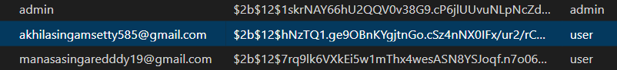
Password encrypted

Slide 12
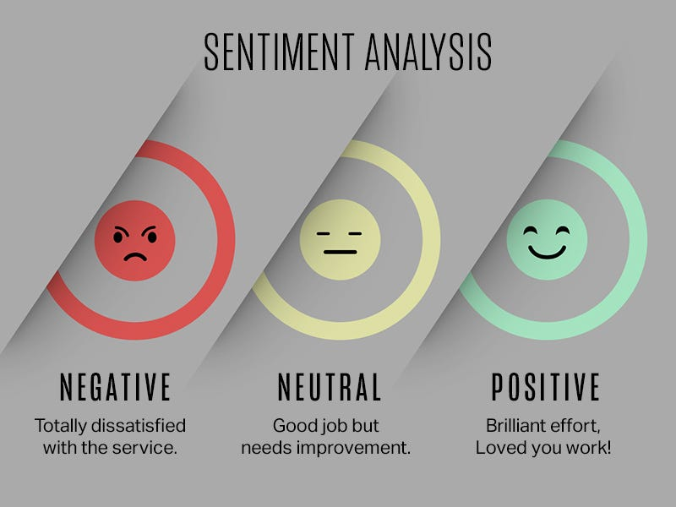
MILESTONE 2: Text Preprocessing & Overall Sentiment Analysis
In this milestone, we focus on processing text data and finding sentiment in reviews.
First, we build a text preprocessing pipeline to clean and prepare the raw reviews.
Then, we apply a pre-trained AI model to classify each review as Positive, Negative, or Neutral.
Finally, we update the web interface so users can see reviews along with their sentiment results.

Slide 13
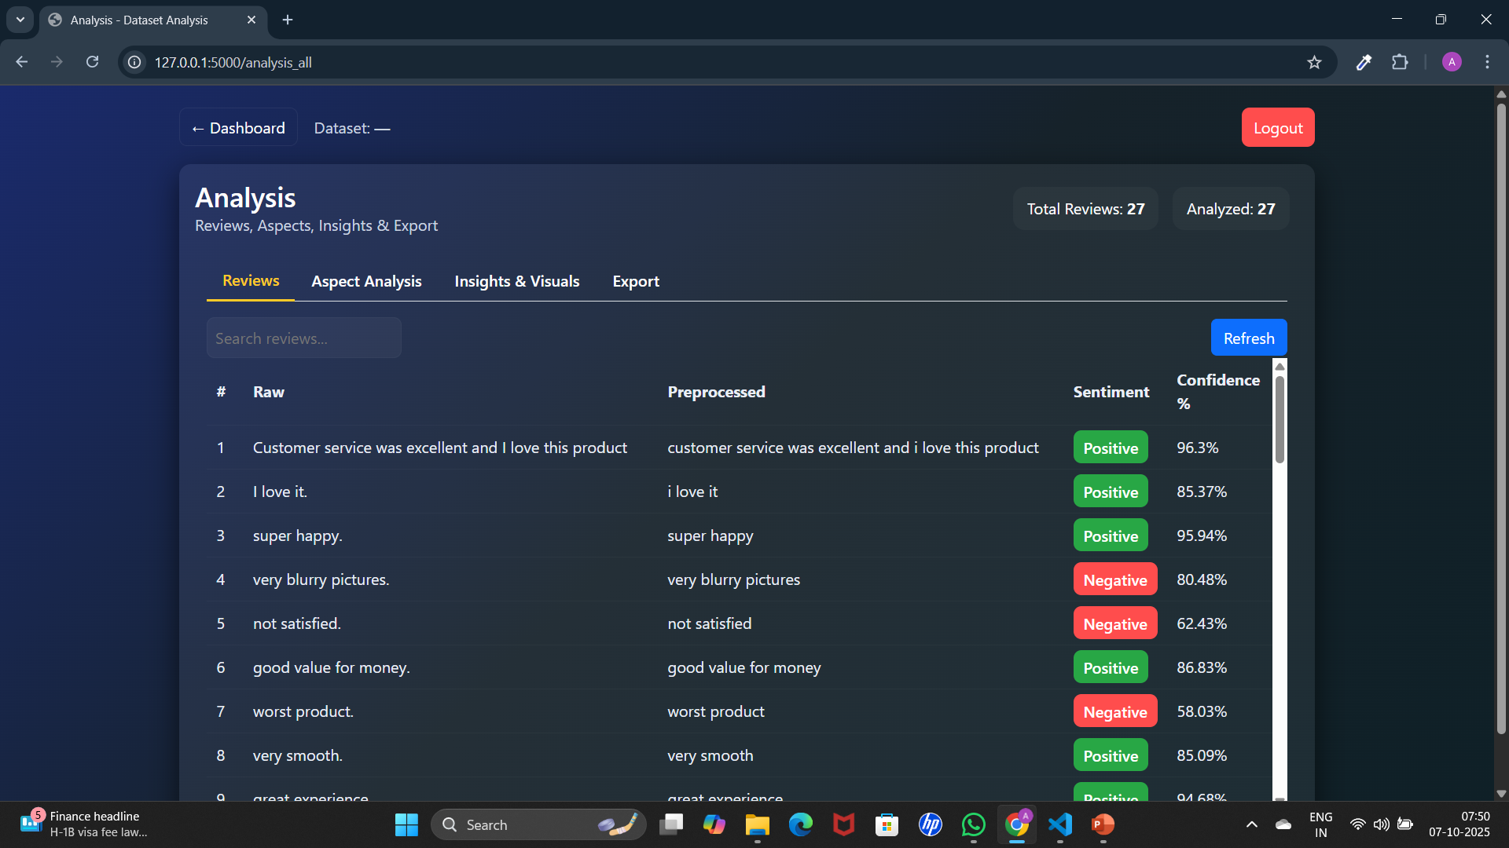
Raw & Preprocessed reviews

Slide 14
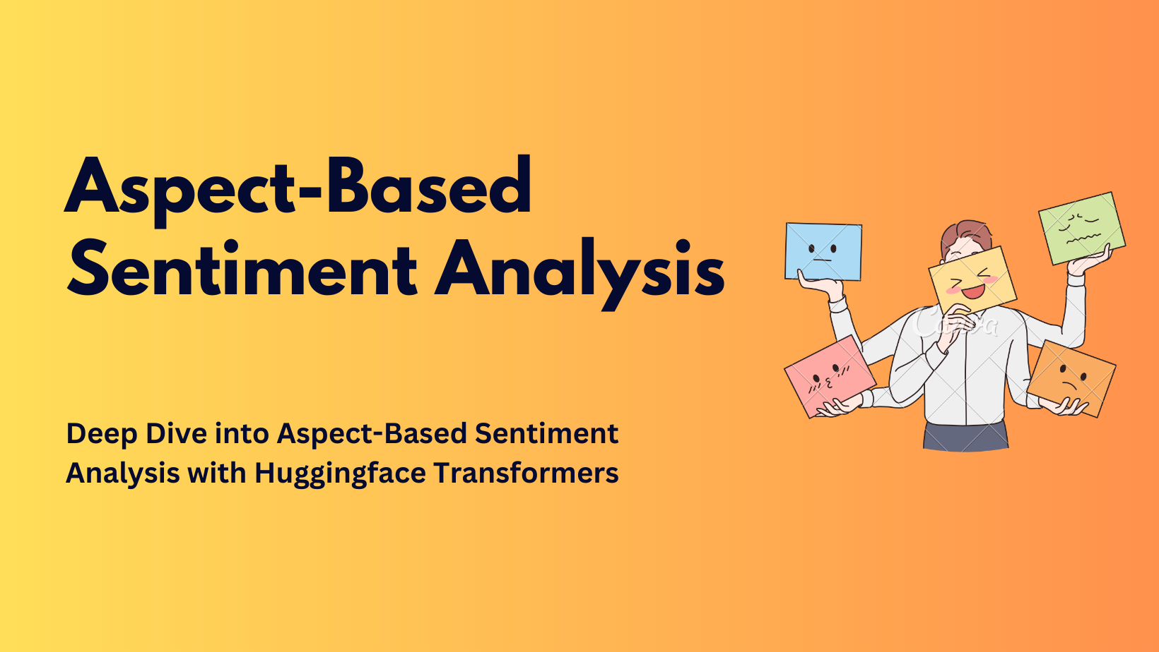
MILESTONE 3 Aspect-Based Sentiment Analysis (ABSA)
In this milestone, we focus on:
Extracting aspects (e.g., battery, service,
camera) from user reviews.
Identifying sentiment (positive/negative/
neutral) for each aspect.
Using rule-based methods, lexicons, and
contextual analysis for accuracy.
Aggregating data to show counts, averages, and sentiment distribution.
Providing a clear dashboard view with highlighted aspects and confidence scores.

Slide 15
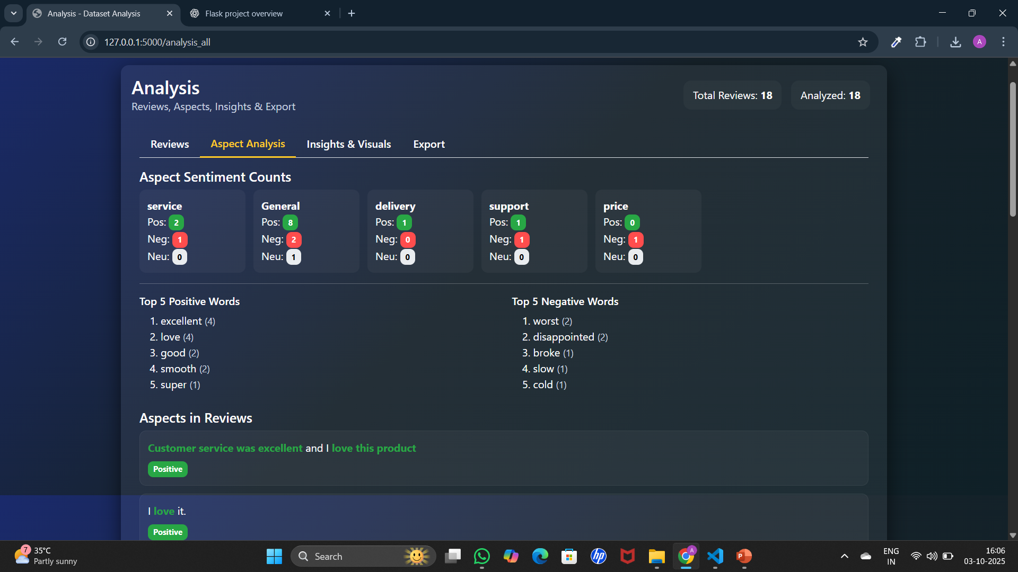
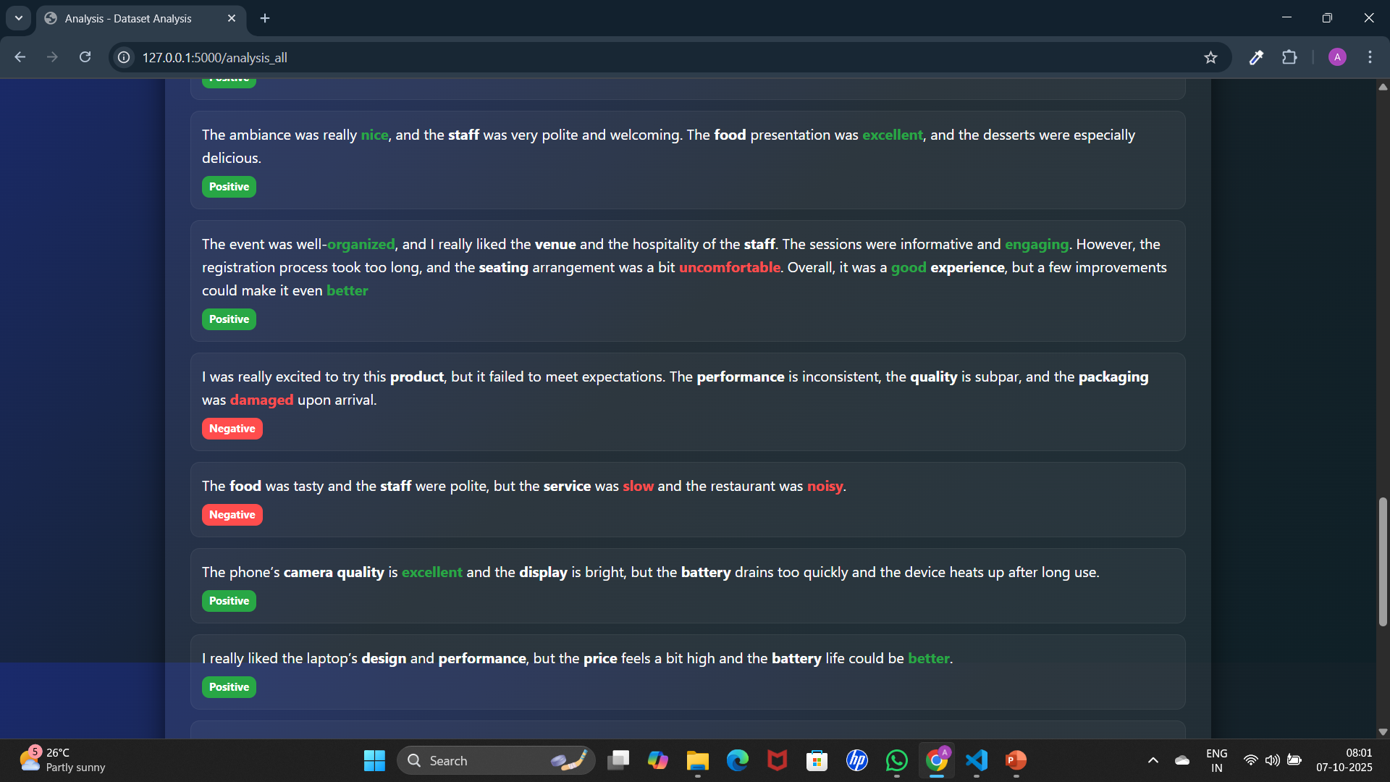

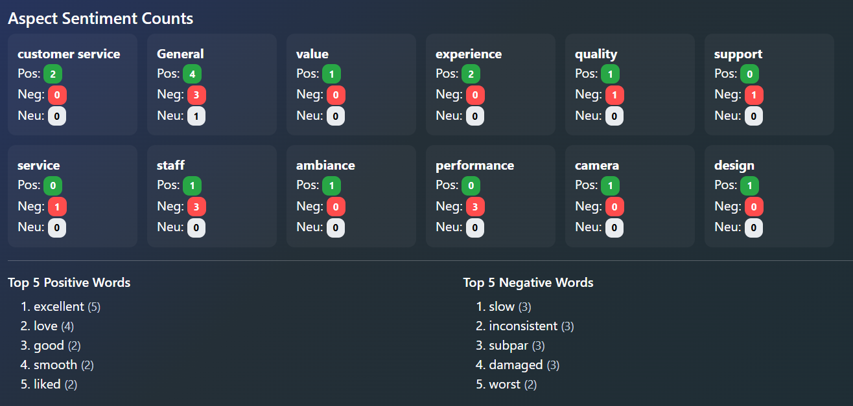
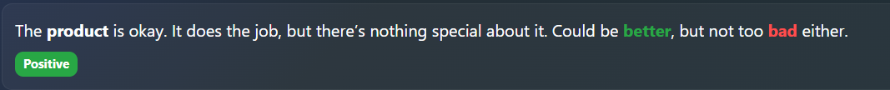
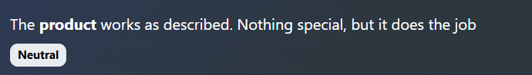
Aspect analysis in user dashboard

Slide 16
Milestone 4 : Visualization, Admin Management & Deployment
This milestone focuses on visualization, admin management, and deployment, including interactive dashboards (Streamlit/Dash/Plotly) for sentiment analysis and an admin dashboard (Flask/Dash) for aspect management and system monitoring. The project will be containerized with Docker, deployed on free platforms, and completed with documentation and a final presentation. Admin Management: Manage aspect categories Monitor usage and logs Validate sentiment analysis Configure basic settings

Slide 17
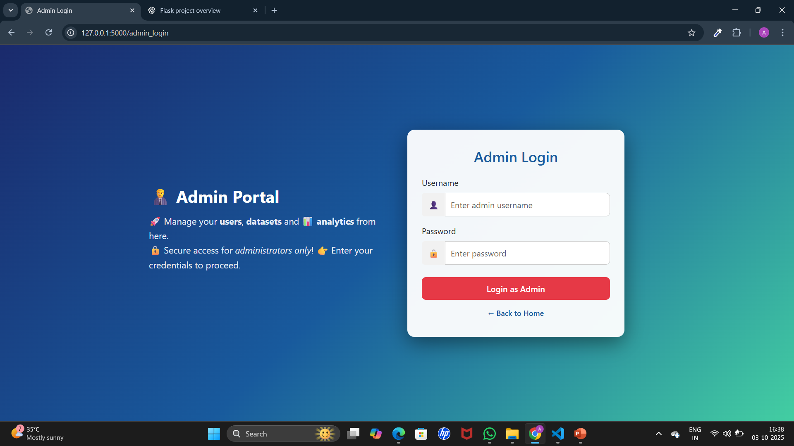
Admin Login

Slide 18
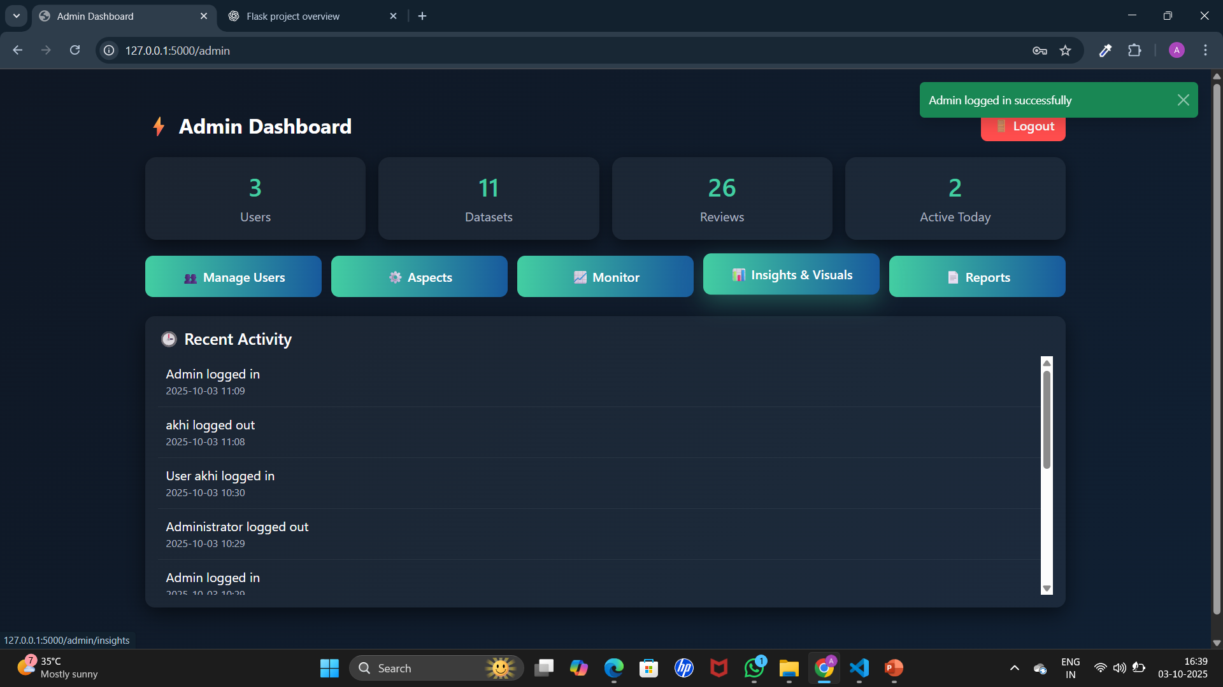
Admin Dashboard

Slide 19
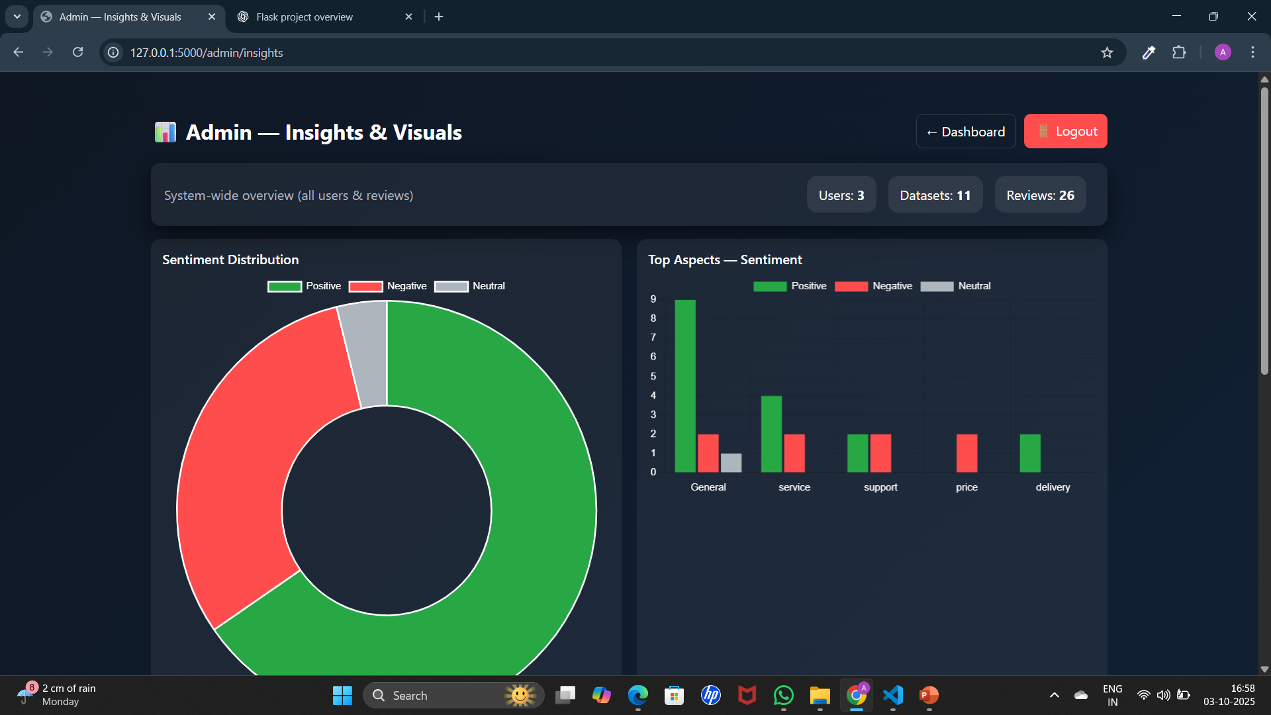
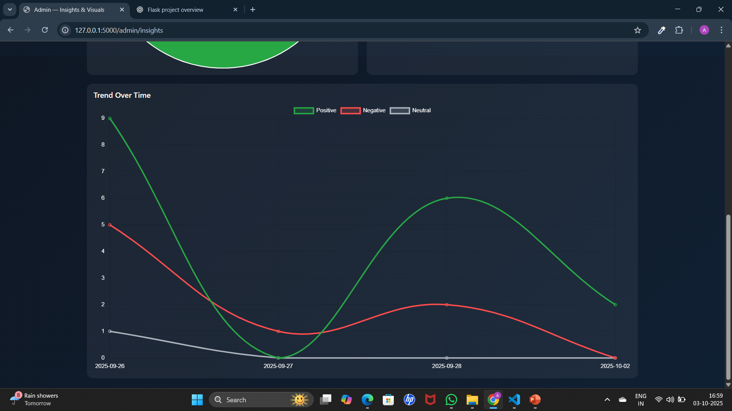
Insights & Visuals

Slide 20

The Customer Review Insight AI project successfully delivers an automated, aspect-based sentiment analysis system that transforms raw customer feedback into actionable insights. By combining advanced NLP techniques with an intuitive interface, it enables businesses to quickly identify strengths and weaknesses at a granular level, supporting data-driven decisions and improved customer satisfaction. The project is scalable, deployment-ready, and demonstrates the practical value of modern AI in real-world business applications.

Slide 21


